Slide 1
Acute Postoperative Pain
Bhagya Gunetilleke
Consultant Anaesthetist
Senior Lecturer
Department of Surgery

Slide 2
Case History
50 year old man has gangrene of the right foot. He is to undergo a below knee amputation.
How would you manage the pain in the pre/intra/post op periods

Slide 3
Objectives
Understand
Why pain needs to be controlled
Pathophysiology of acute pain
How to assess acute pain
How to plan an analgesic regime
How to monitor for adverse effects

Slide 4
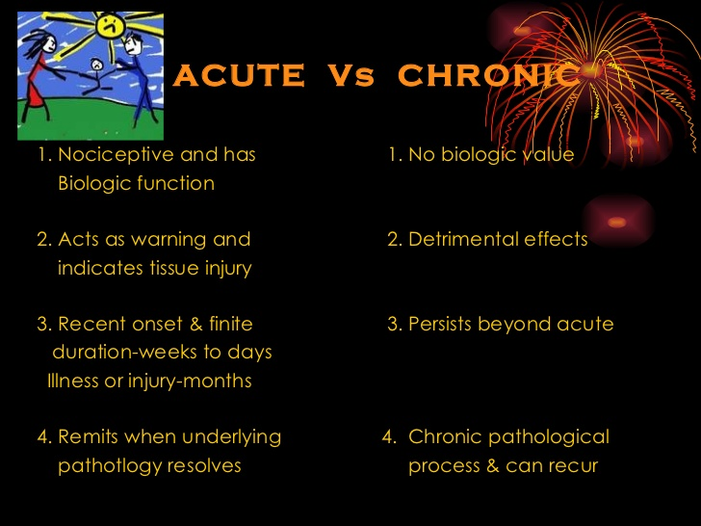

Slide 5
Why Control Pain?
Alleviate human suffering
Effects on blood pressure, diabetes, IHD, mood
Facilitate breathing, mobility, human interaction, activities of daily living
But, under-recognized & under-treated
Leads to structural & functional changes in the CNS – Chronic Pain

Slide 6
Definition of Pain
Working Definition – “the normal, predicted physiological response to an adverse chemical, thermal or mechanical stimulus… associated with surgery, trauma and acute illness”
DB Carr, LC Goudas - The Lancet, 1999
Individuals respond differently

Slide 7
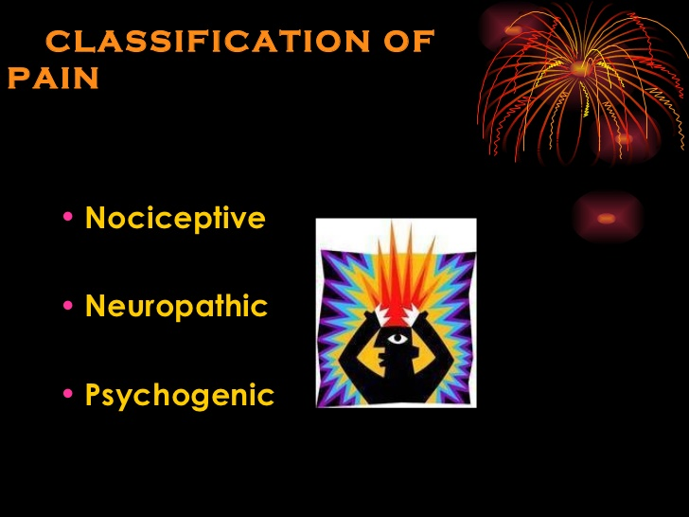

Slide 8
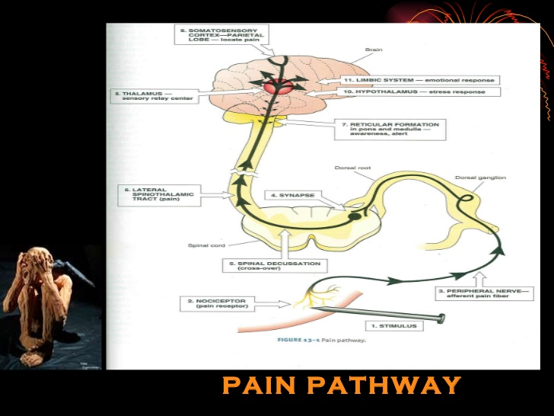
Pathophysiology of Pain –I
Pain conduction pathway

Slide 9
Sensing Pain
Physical, chemical, thermal stimuli
Nociceptors – Free nerve endings of specialized nerve fibres
Transduce (convert) physical stimulus to electrical stimulus
Na⁺ channels, Voltage generated
If threshold is reached, the impulse is propagated

Slide 10
Perception of Pain
Not proportionate to the stimulus
Varies within & between individuals
Modulated by
therapeutic interventions
emotional status of individual

Slide 11
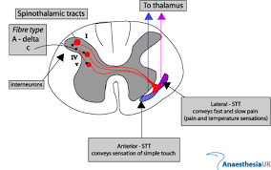
Spinal Cord - I

Slide 12
Spinal Cord - II
Dorsal horn neurons – Cell bodies of 1st order neurons
Wide dynamic range(WDR) neurons – Rexed layer 3,4 & 5 also respond to light touch
‘Wind up” & ‘Convergence’

Slide 13
Spinal Cord - III
Spinothalamic tract – pain fibers
Spinoreticular tracts- pain fibers modulated by descending impulses
Spinomesencephalic tract – mediates autonomic responses to pain

Slide 14
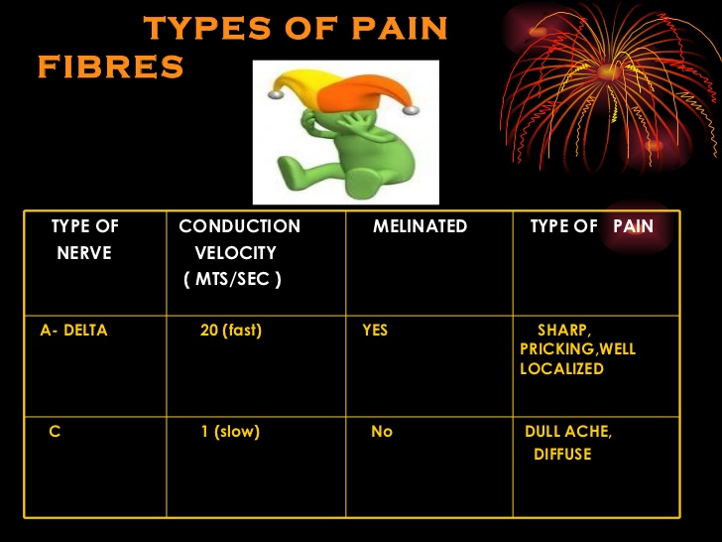

Slide 15
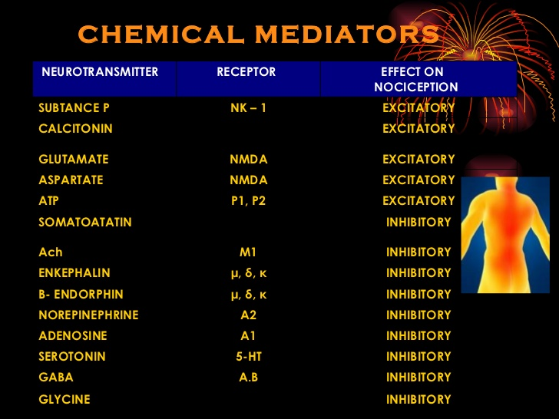
Pathophysiology of Pain - Mediators

Slide 16
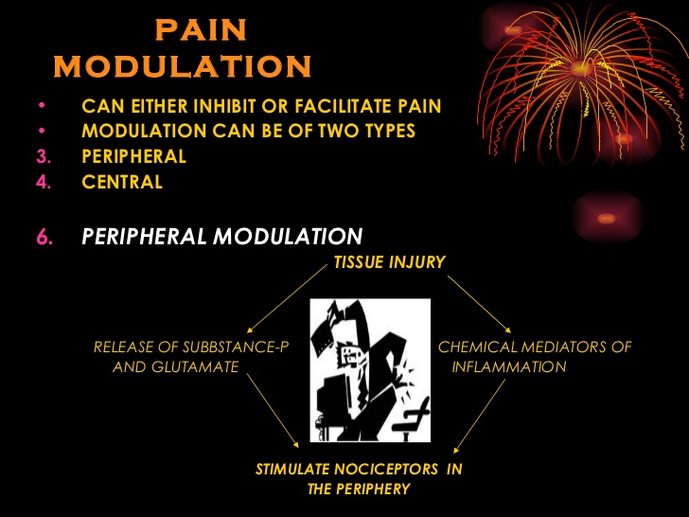
Pathophysiology of Pain - Modulation
Sensitization of receptors
Histamines, capsaicin, substance P, bradykinin,prostaglandins

Slide 17
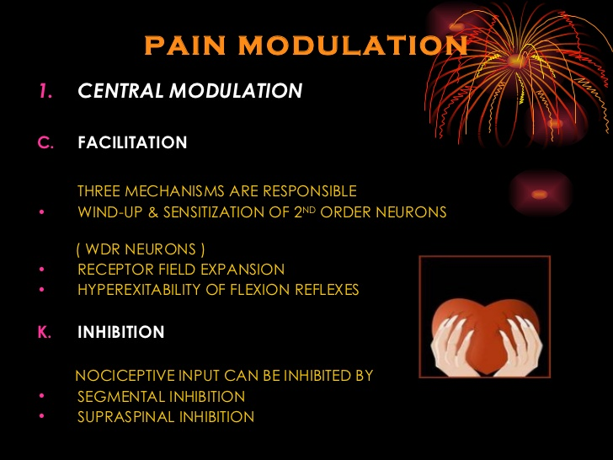

Slide 18
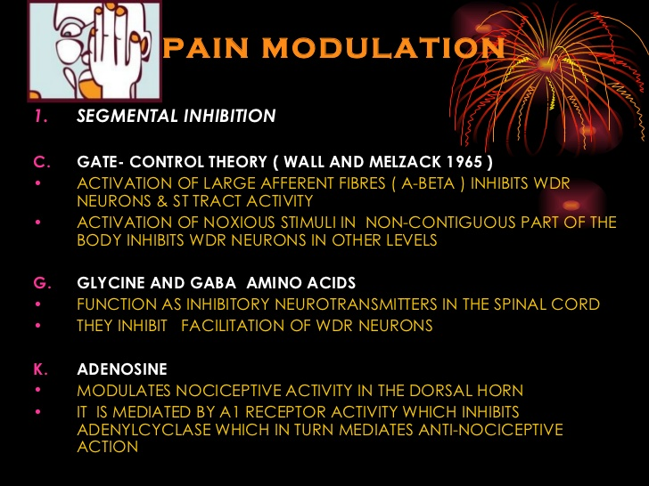

Slide 19
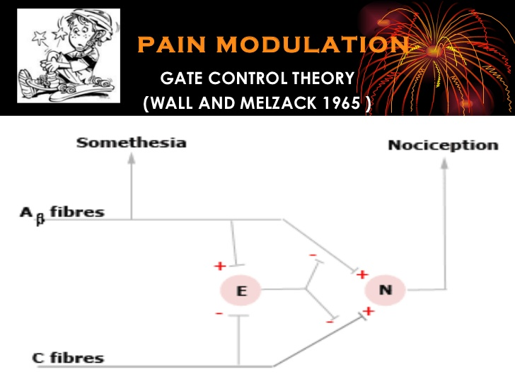

Slide 20
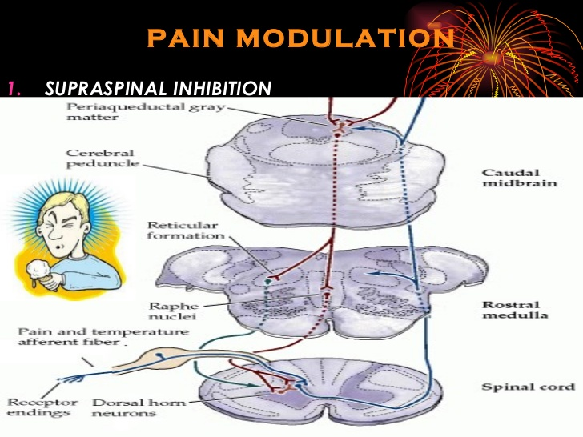

Slide 21
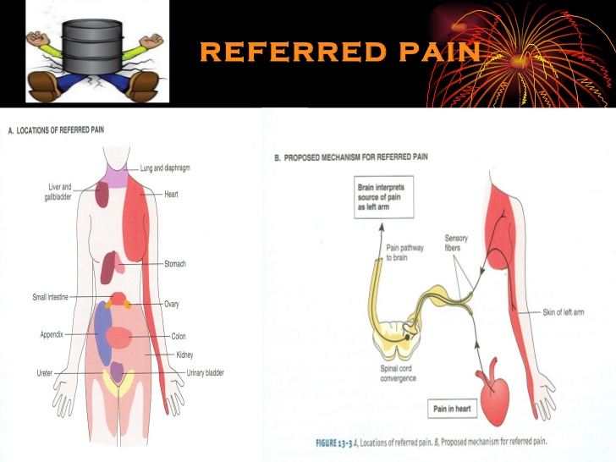

Slide 22
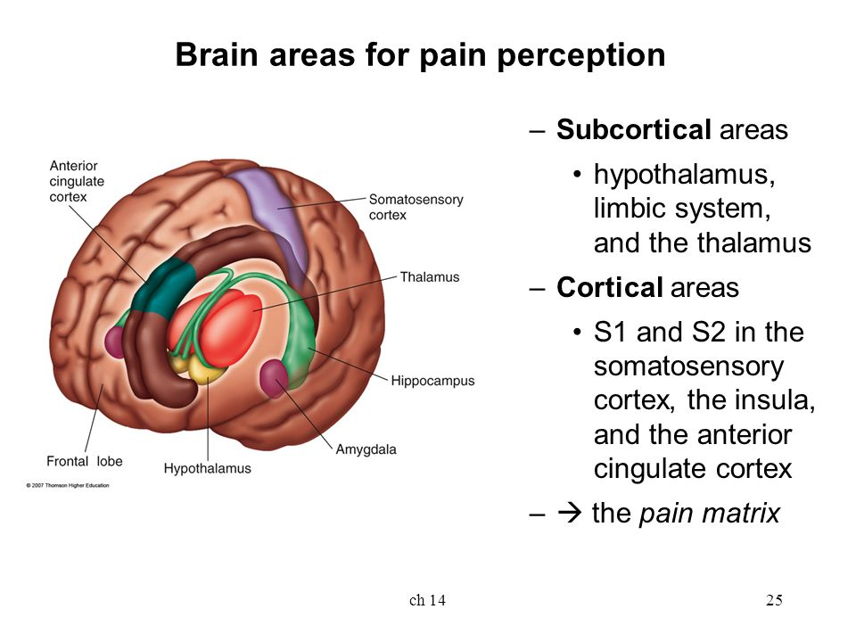

Slide 23
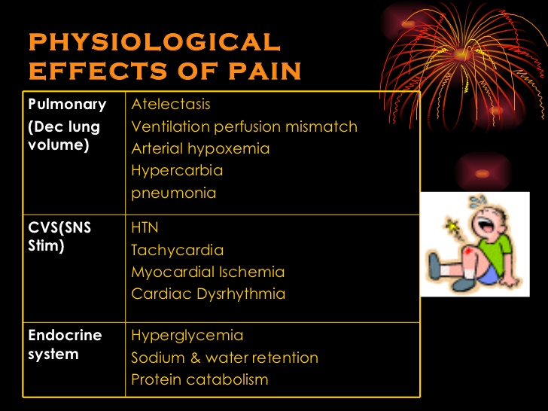

Slide 24
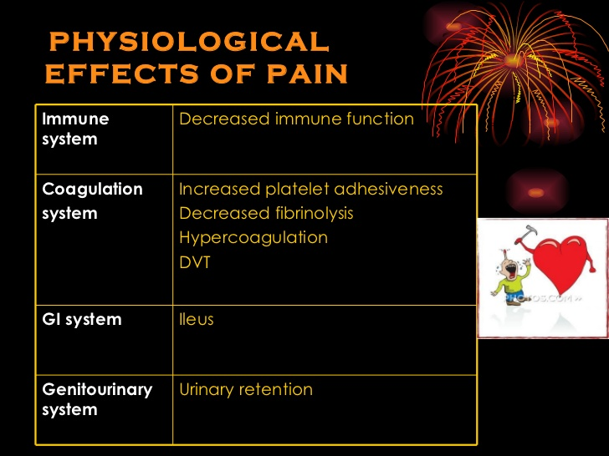

Slide 25
Assessment of Pain
Wide variation in response to pain
Expression may be affected by age, intelligence, level of conciousness, other factors
Perception of pain varies among medical practitioners
Universally accepted pain ratings

Slide 26
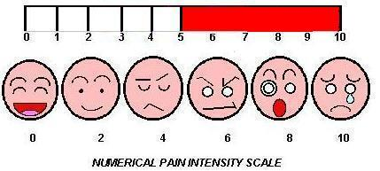
Assessment of Pain
Tools for assessment of pain
Visual analogue scale
Pain score
Smiley faces

Slide 27
Planning an Analgesic Regime
Anticipate pain
Estimate pain
Multi-modal approach
Individualize treatment according to
Patient perception
Severity of pain
Co-morbidity
Availability

Slide 28
Anticipation
Empathy
Gangrenous foot – Severe pain unless neuropathic
Risk of chronic pain post- ampuation
Affects sleep, feeding, control of diabetes, hypertension, IHD

Slide 29
Estimate Pain
Communicate with patients
Tell the patients relief available
Use assessment tools
Communicate with the rest of the team

Slide 30
Multimodal Approach to Pain Relief
Acute severe pain – immediate, effective control
Eg. Intravenous opiods, neuraxial block (spinal/ epidural), regional local anaesthesia
Combinations of drugs/ route to
Block conduction at different points
Reduce dose related side effects

Slide 31
Individualize Treatment
Consider patients perception of severity
Believe the patient!
Control of acute severe pain – Priority
Comorbidity eg. Coagulopathy- avoid NSAIDs/ intramuscular injections
Allergies/ intolerance to drugs
Availability of– Drugs/ equipment/ skills/ staffing

Slide 32
Case History
Anticipated severity of pain- Intensely severe
Estimate of severity – Mild
Moderate
Severe
Multimodal – IV opioid/ neuraxial –
spinal/epidural
+/- NSAIDs
+/- Paracetamol
+ Surgery

Slide 33
Monitoring
Opioids – Respiratory depression – Monitor respiratory rate, level of sedation
Nausea/ vomiting
Neuraxial local anaesthetics – Hypotension, urinary retention, pruritus, limb weakness
NSAIDs – Renal function, gastric irritation, bronchospasm, platelet dysfunction
Tramadol - Nausea/ vomiting,

Slide 34
Summary
Pain is real!
Wide variation in perception & response to pain
Pain affects function of all organ systems
Pain control improves well being & reduces harmful effects
Assess severity & response to analgesics
Acute pain – aggressive treatment
Multimodal analegesic regime

